Slide 1
Some of the common terms teams will need to understand when using GitHub.
Repository (repo) — a folder in which all files and their version histories are stored.
Branch — a workspace in which you can make changes that won’t affect the live site.
Markdown (.md) — a way to write in Github that converts plain text to GitHub code. Sites such as Atom and Sublime Text are examples of free resources for developers using Markdown.
Commit Changes — a saved record of a change made to a file within the repo.
Pull Request (PR) — the way to ask for changes made to a branch to be merged into another branch that also allows for multiple users to see, discuss and review work being done.
Merge — after a pull request is approved, the commit will be pulled in (or merged) from one branch to another and then, deployed on the live site
Issues — how work is tracked when using git. Issues allow users to report new tasks and content fixes, as well as allows users to track progress on a project board from beginning to end of a specific project.
Federalist — a platform that securely deploys a website from a GitHub repository in minutes and lets users preview proposed and published changes.

Slide 2
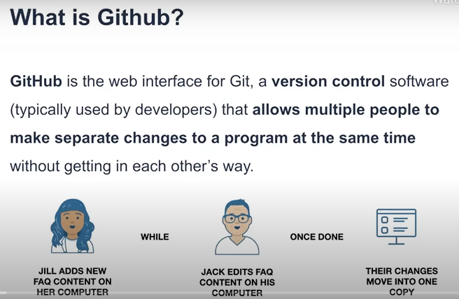
https://digital.gov/resources/an-introduction-github/

Slide 3
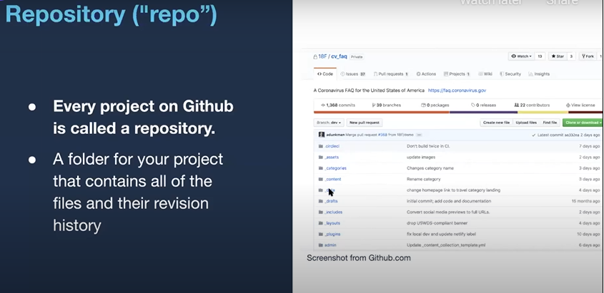

Slide 4
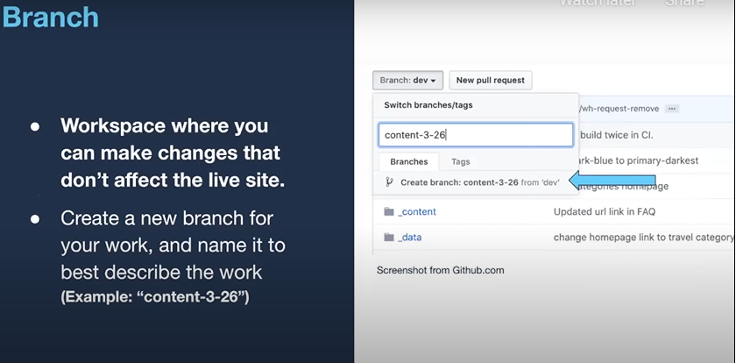

Slide 5
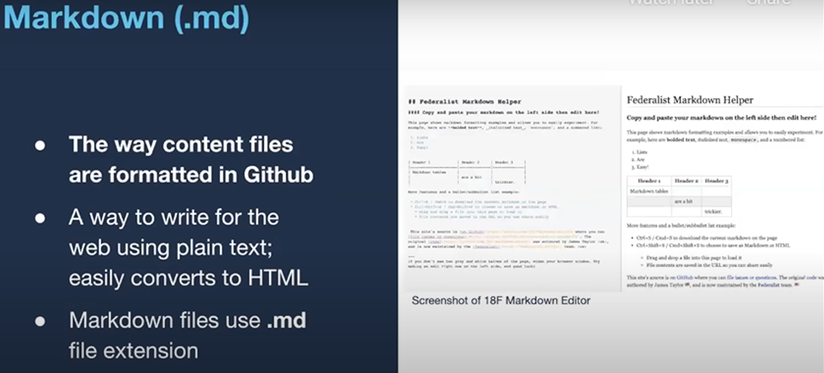

Slide 6
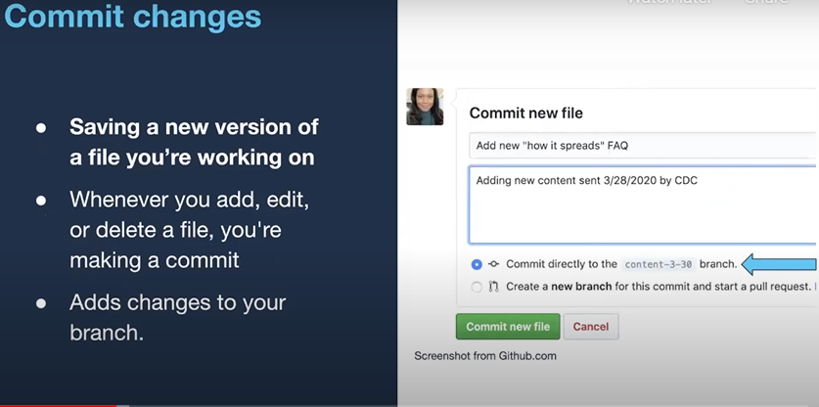

Slide 7
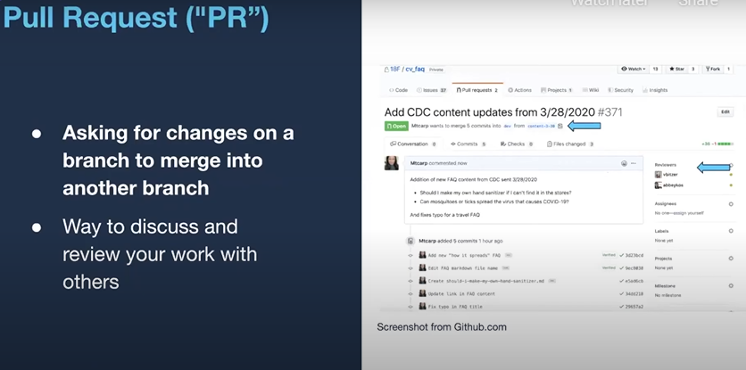

Slide 8
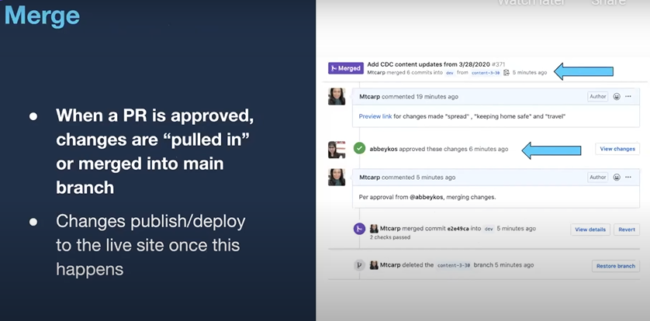

Slide 9
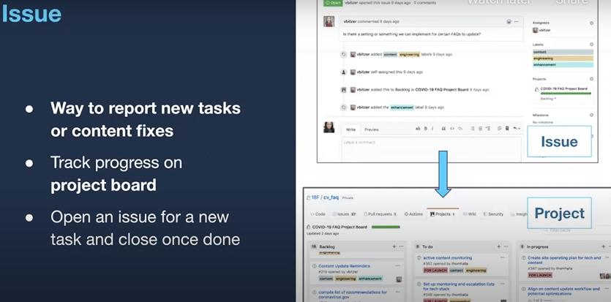

Slide 10
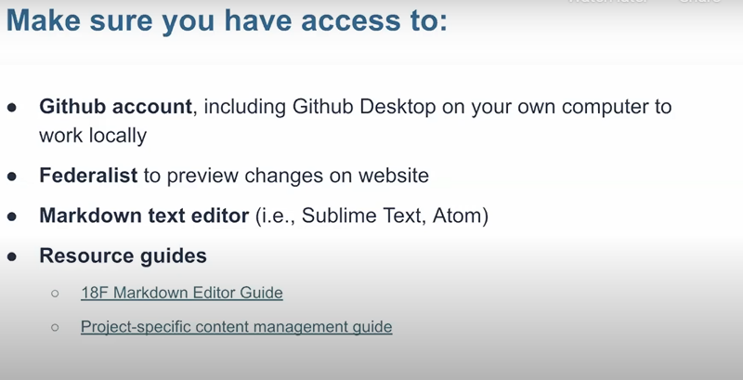

Slide 11
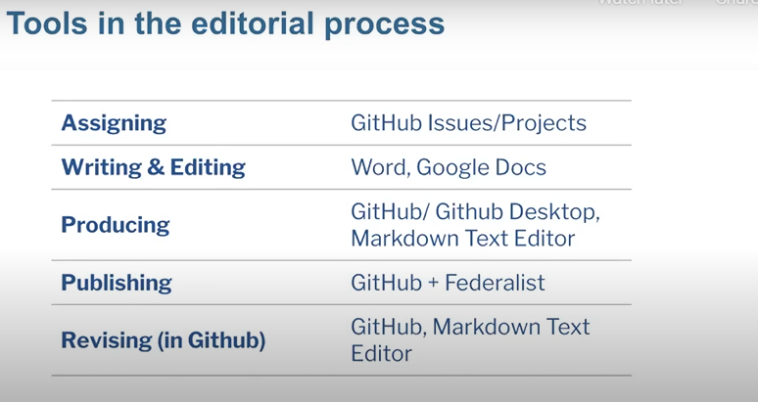

Slide 12
How Do I Use GitHub?
How files are changed and merged in GitHub. This can be done by any member on the team, developers and non-developers, that has access to a GitHub repository.
The following is a step-by-step method in which GitHub users can develop their websites:
Step 1 — Team members will open an issue via a project board.
Step 2 — Team members will create a new branch from the most recent version of the main branch in the repository where the entire team works to avoid conflicts.
Step 3 — Team members will add commits (edits/ changes) to their respective branches.
Step 4 — Team members will open a pull request in which users can assign other team members to review content changes and internally discuss the details of the commits.
Step 5 — After waiting for the Federalist build to complete, team members can preview the change on a test version of the website and request reviewers to approve or comment on the change. Once the reviewers approve the pull request, the commits merge into the main branch and are published on the live site.

Slide 13
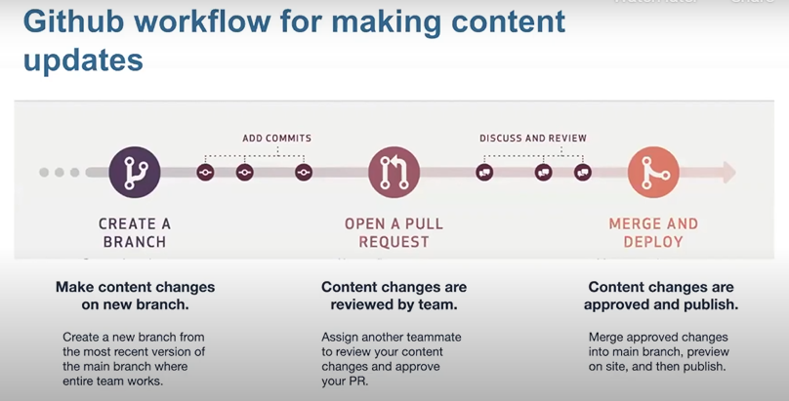

Slide 14
Additional Resources
Intro to GitHub | TTS Handbook - a guide on how to use GitHub from understanding basic level terminology to understanding more complicated concepts
Simple Guide to GitHub for Non-Developers - a resource that explains the basics of GitHub language
Getting Started with GitHub Desktop - a guide to help GitHub Desktop users understand how to work from a local computer
18F Markdown Helper and Markdown Cheat Sheet - are tools to help users transcribe plain text language into GitHub code
https://www.youtube.com/watch?v=3Tn58KQvWtU How To Use GitHub with VS Code in 2020 | Commit & Push | Part 1
https://www.youtube.com/watch?v=sz2EM-gkEs0 How To Use GitHub with VS Code in 2020 | Clone | Part 2
https://www.youtube.com/watch?v=F2DBSH2VoHQ How to use Git inside of VSCode - 2020

Slide 15
Git in VSCode videos
https://www.youtube.com/watch?v=F2DBSH2VoHQ 12 minutes
https://www.youtube.com/watch?v=QGINQkd1Tzw 7 minutes
Video: How to use PowerShell 7 in Visual Studio Code – SID-500.COM 5 minutes

